Slide 1



FirefighterHub: Modern Shift Management System
Professional shift management and hold rotation tracking designed specifically for fire departments. Real-time synchronization across A, B, and C shifts with comprehensive audit trails.

Slide 2

Complete Shift Management Solution
Hold Rotation Tracking
Real-Time Roster Sync
Automated rotation system ensures fair distribution. Track 12-hour and 24-hour holds with 72-hour advance notice validation.
Changes sync instantly across all devices. View availability, certifications, and apparatus assignments at a glance.
Certification Management
Complete Audit Trail
Track FTO, BLS, ALS, and apparatus certifications. Ensure compliance with staffing requirements automatically.
Every action logged with timestamp and user. Comprehensive activity history for accountability and reporting.

Slide 3

Built for Fire Department Operations
Shift-Isolated Data
Battalion Chief Controls
Complete separation between A, B, and C shifts. Each shift maintains independent rosters and rotation orders.
Administrative mode with enhanced permissions. Manage rosters, override rotations, and access comprehensive reports.
Independent rotation queues
Shift-specific hold calendars
Bulk operations support
Isolated activity logs
Position reordering tools
Cross-shift transfer capability
Export capabilities (CSV/JSON)
Advanced filtering options

Slide 4
Intelligent Rotation System
01
02
Automatic Position Management
Fair Distribution Logic
System maintains rotation order automatically. Completed holds move firefighters to bottom of queue.
Recalculates positions after every change. Ensures equitable hold distribution across all active members.
03
04
Availability Tracking
Historical Analytics
Real-time status updates for each firefighter. Unavailable members automatically skip rotation.
Complete hold history per firefighter. Track patterns and generate compliance reports.

Slide 5
Real-Time Collaboration
<200ms
10
3
Sync Speed
Retry Attempts
Shift Coverage
Changes propagate across all connected devices in under 200 milliseconds.
Exponential backoff ensures reliable connections even with unstable networks.
Complete support for A, B, and C shift rotations with independent management.
Supabase real-time subscriptions provide instant updates. Robust error handling with automatic reconnection ensures continuous operation.

Slide 6
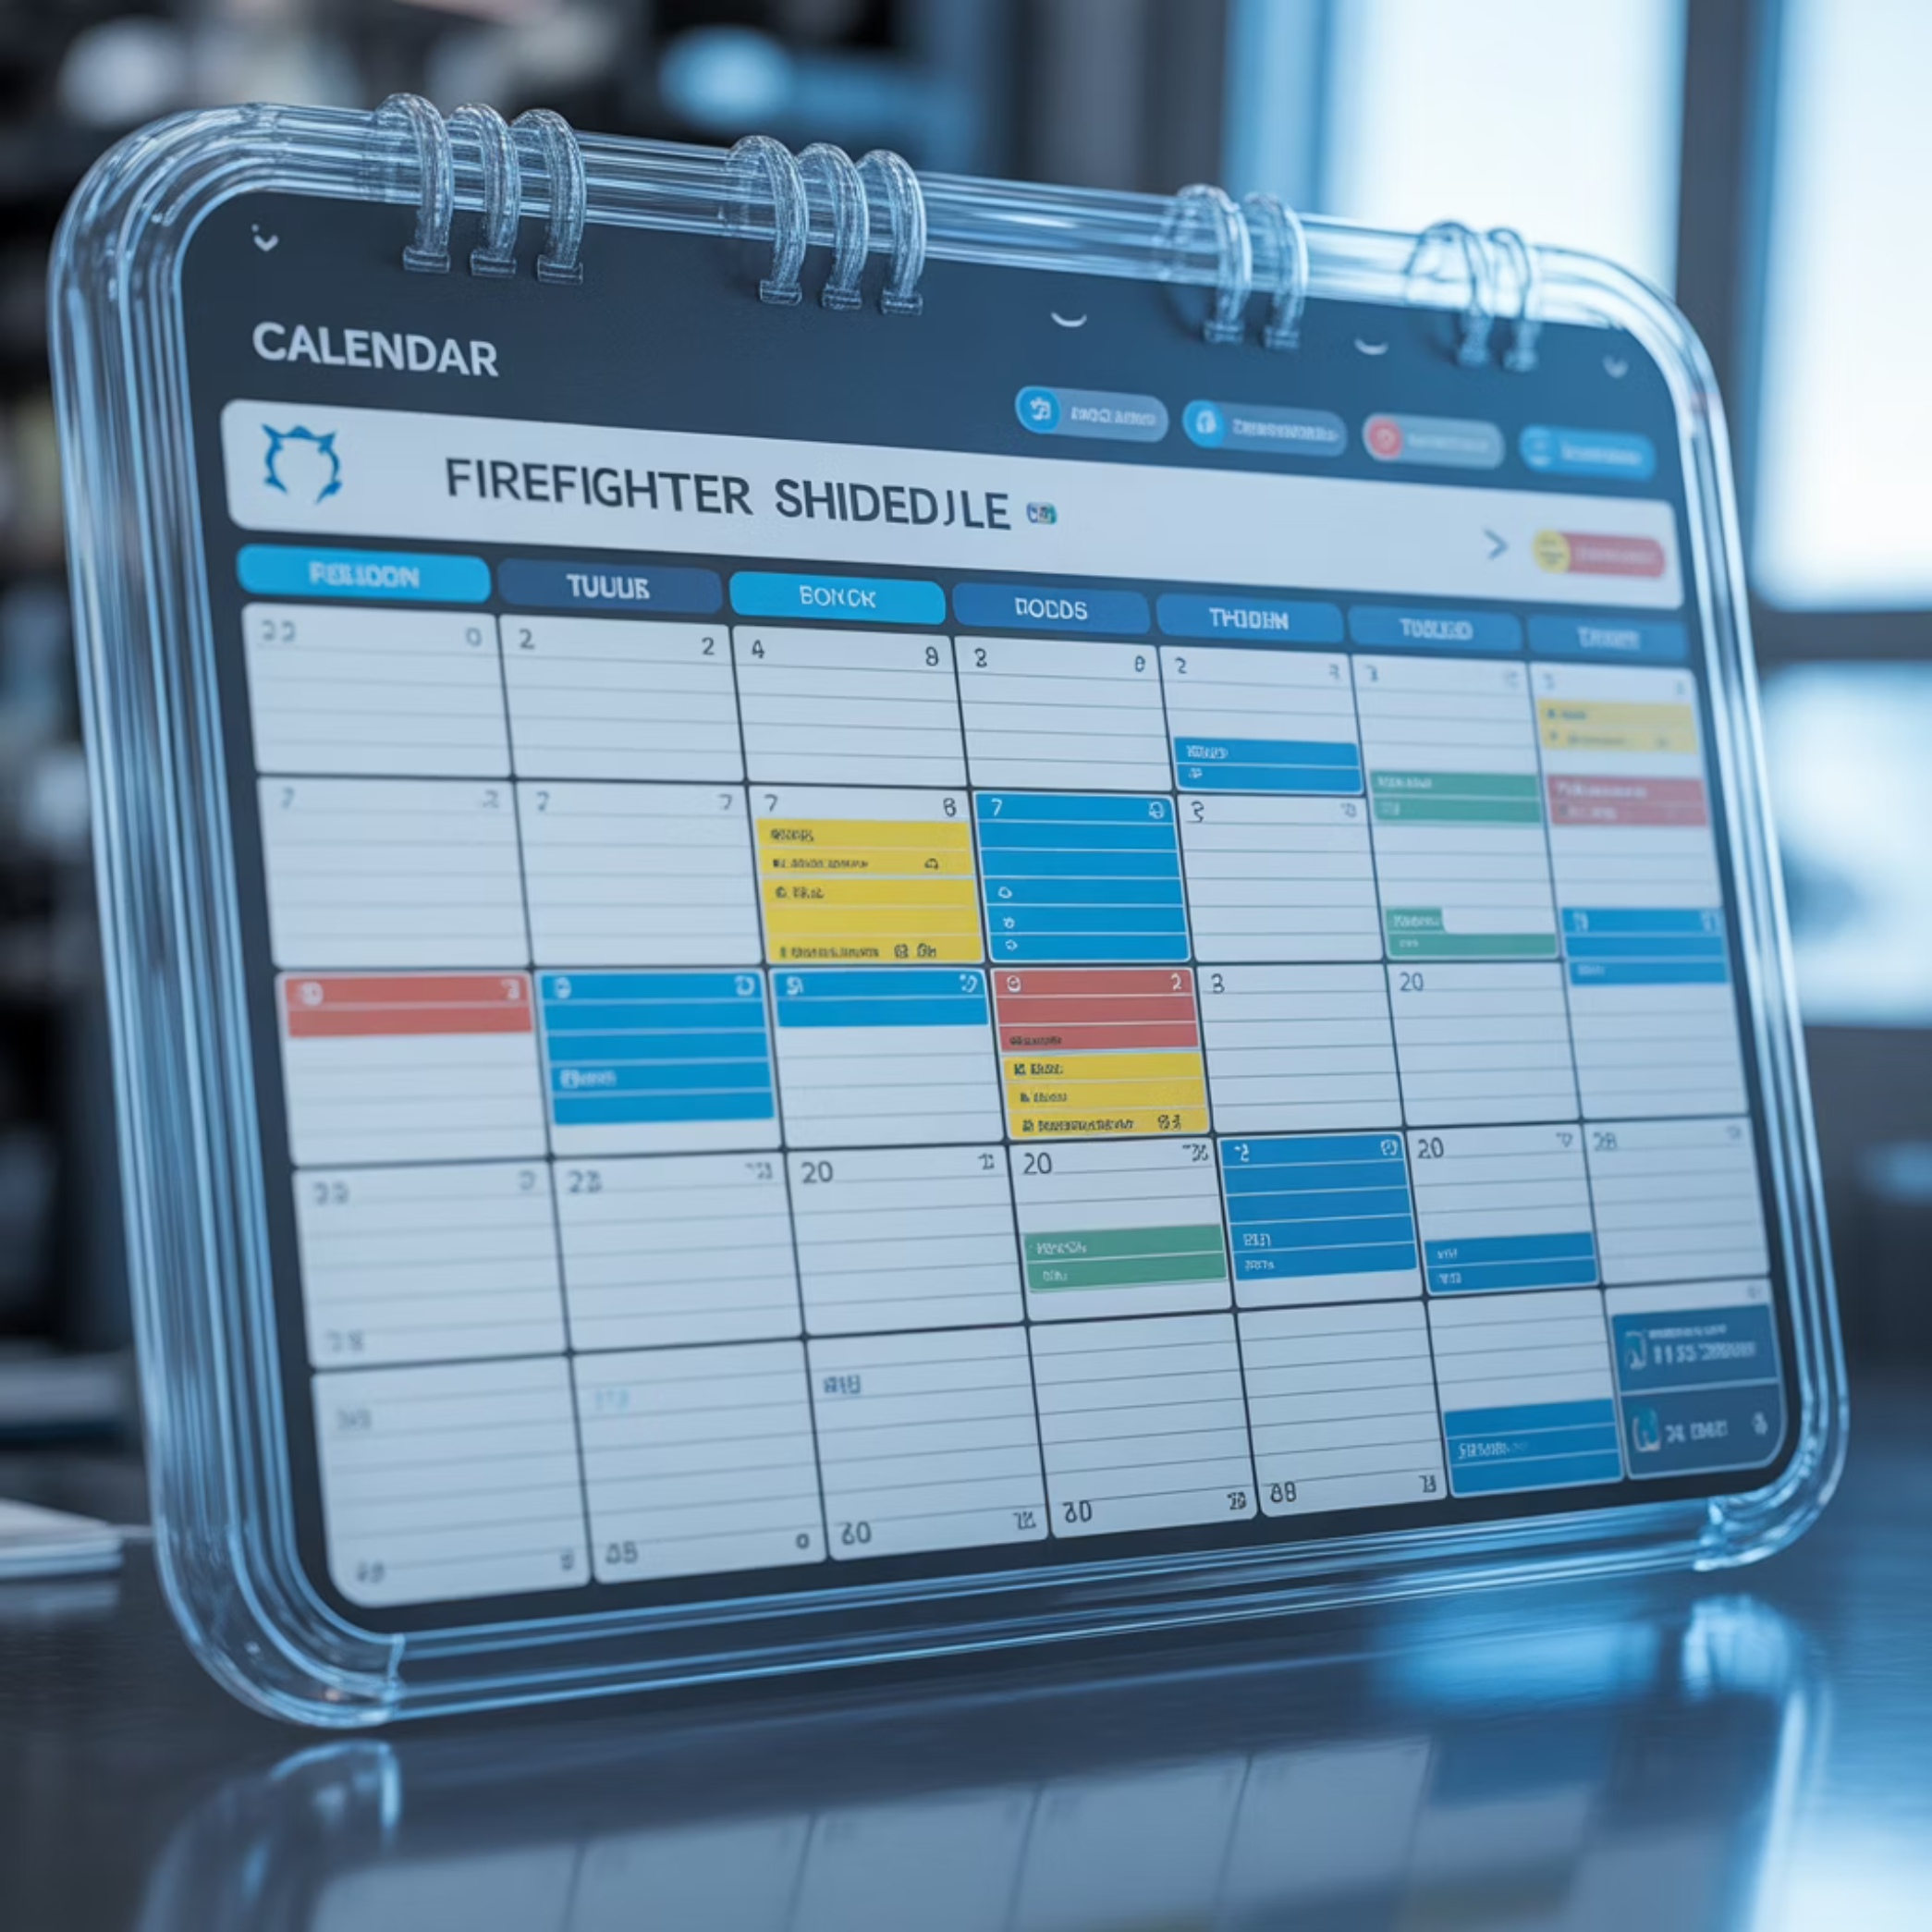
Comprehensive Calendar View
Visual Schedule Management
Monthly calendar displays all scheduled and completed holds. Color-coded status indicators provide instant visibility.
Blue badges: Scheduled holds
Teal badges: Completed holds
Station numbers displayed
Click any date to schedule
72-hour advance validation

Slide 7




Advanced Search and Filtering
Name Search
Station Filter
Real-time filtering by firefighter name. Case-insensitive instant results.
Filter roster by fire station number. Quick access to station-specific crews.
Status Filter
Bulk Operations
View active or deactivated members. Toggle availability status instantly.
Multi-select with batch actions. Deactivate or delete multiple records safely.

Slide 8
Professional Data Export
CSV Export
JSON Export
Complete roster data in spreadsheet format. Includes all fields with proper escaping.
Structured data for system integration. Machine-readable format for automation.
Timestamped filenames
Complete data structure
Shift-specific exports
API-ready format
All certification data
Backup capability
Compatible with Excel
Migration support

Slide 9
Mobile-Optimized Interface
Responsive Design
Tablet Support
Desktop Power
Full functionality on smartphones and tablets. Touch-optimized controls with 44px minimum targets.
Optimized layouts for iPad and Android tablets. Efficient use of larger screens.
Advanced features and bulk operations. Multi-column layouts for maximum efficiency.

Slide 10
Accessibility First
WCAG 2.1 AA Compliant
High Contrast Modes
Full keyboard navigation support. Screen reader compatible with ARIA labels throughout.
Dark and light themes with proper contrast ratios. Amber certification badges meet 4.5:1 standards.
Touch Target Compliance
Focus Management
All interactive elements meet 44px minimum size. Comfortable tapping on mobile devices.
Clear focus indicators on all controls. Logical tab order through interface.

Slide 11
Robust Security Architecture
Row-Level Security
Environment Variables
PostgreSQL RLS policies protect all data. Shift-isolated queries prevent cross-contamination.
Zero credentials in source code. All secrets managed through environment configuration.
Admin-only write access
Vercel environment integration
Public read for rosters
Local .env.local support
Append-only audit logs
Service role key isolation
Automatic policy enforcement
Anon key public access

Slide 12



Technical Excellence
<100ms
92/100
Hot Module Reload
Lighthouse Score
Lightning-fast development with Vite HMR
Excellent accessibility and performance ratings
0
100%
Console Errors
TypeScript Coverage
Clean production build with zero runtime errors
Fully typed codebase with strict mode enabled

Slide 13
Modern Technology Stack
React 18.3
Vite 5.4
Latest React with concurrent features. TypeScript 5.5 for type safety.
Next-generation build tool. Sub-second hot module replacement.
Supabase
Tailwind CSS
PostgreSQL 17 database. Real-time subscriptions and RLS.
Utility-first styling framework. Consistent design tokens throughout.
Lucide Icons
Vercel Hosting
Professional icon system. 344 icons with consistent styling.
Edge network deployment. Automatic HTTPS and CDN.

Slide 14
Comprehensive Documentation
Setup Instructions
1
Complete database schema and migration scripts. Environment configuration guides.
2
API Reference
Detailed hook documentation. Component prop interfaces and usage examples.
Architecture Guide
3
System design patterns explained. Real-time sync implementation details.
4
Security Procedures
Credential rotation workflows. RLS policy management instructions.

Slide 15



Get Started Today
Ready to modernize your shift management?
FirefighterHub provides everything fire departments need for efficient hold rotation tracking. Real-time synchronization, comprehensive audit trails, and mobile-optimized interface.
Zero setup fees
Open source codebase
Self-hosted option available
Active development and support

